Slide 1
Athlete Media Appearance Schedular
SlideMake.com

Slide 2

Introduction to Athlete Media Appearance Scheduler
The Athlete Media Appearance Scheduler is a tool designed to streamline media engagements for athletes.
It helps in organizing and optimizing the time athletes spend on promotional activities.
The scheduler aims to balance athletes' training, competition, and media obligations effectively.
Notes:
Image source: https://believeperform.com/product/how-coaches-can-become-more-aware-of-their-athletes-mental-health/

Slide 3

Importance of Media Appearances
Media appearances are crucial for building an athlete's personal brand and public image.
They provide opportunities for sponsorships and endorsements, contributing to the athlete's income.
Engaging with media helps athletes connect with their fans and the larger community.
Notes:
Image source: https://www.zerotoskill.com/personal-appearances/

Slide 4
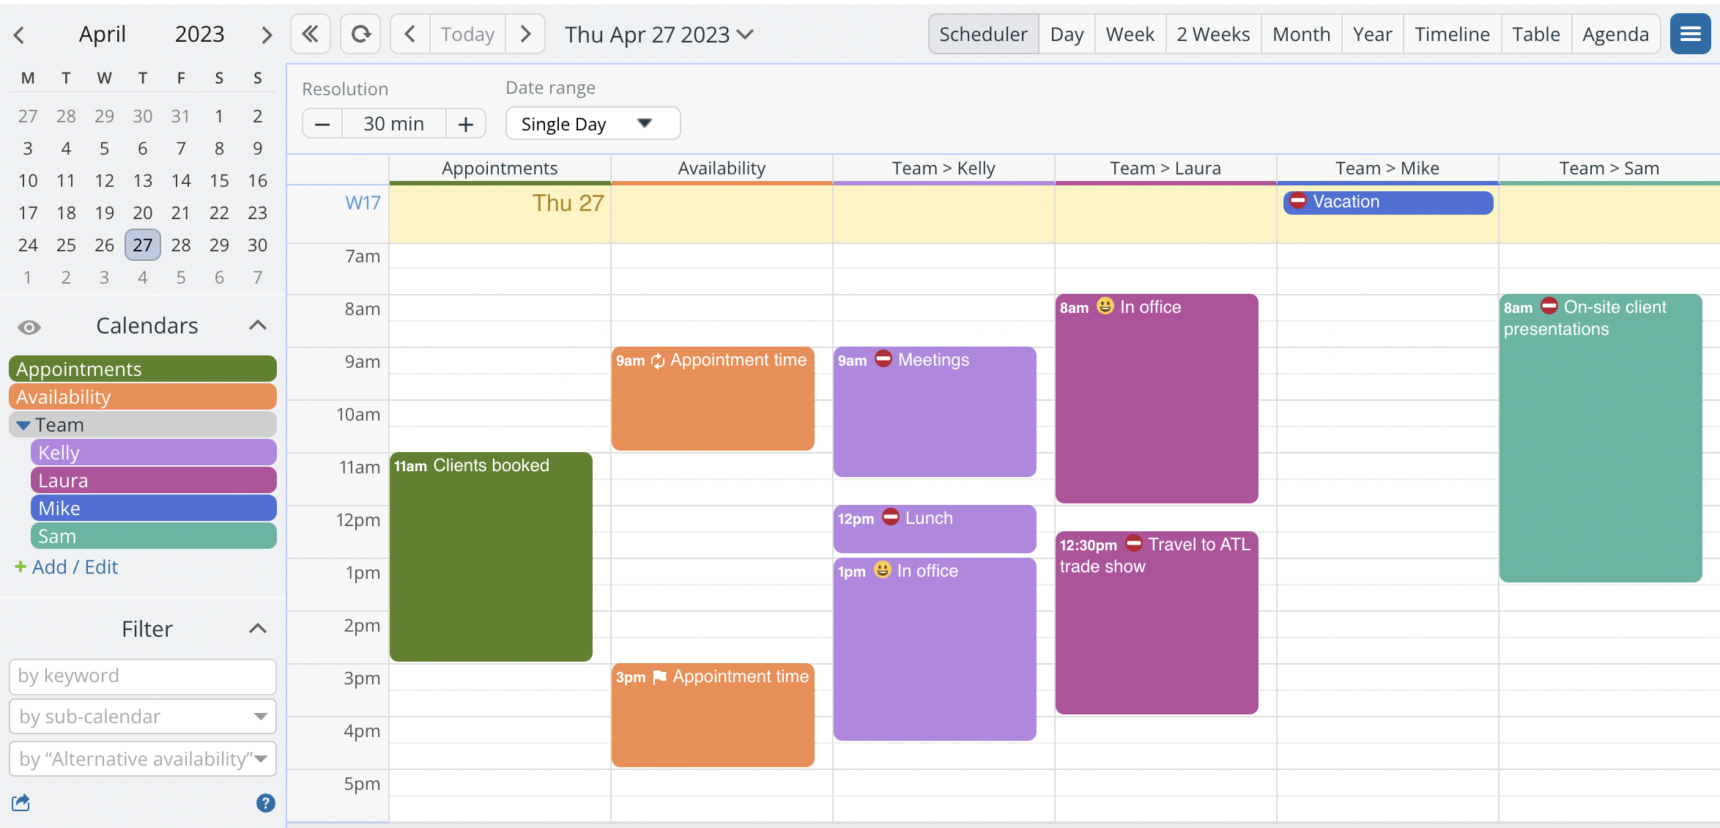
Features of the Scheduler
The scheduler includes calendar integration to avoid conflicts with training and competition schedules.
It offers automated reminders for upcoming media obligations to ensure timely appearances.
The tool provides analytics on media engagement to help athletes understand their audience reach.
Notes:
Image source: https://randiewjobi.pages.dev/jzcvjm-scheduler-calendar-2024/

Slide 5
How to Use the Scheduler
Athletes can input their availability and preferences for media engagements into the system.
The scheduler can suggest optimal times for appearances based on the athlete's existing commitments.
Users can track their media appearances and adjust future schedules based on past performance.
Notes:
Image source: https://www2.deloitte.com/xe/en/insights/industry/technology/technology-media-and-telecom-predictions/2021/athlete-data-analytics.html

Slide 6
Benefits for Athletes
The scheduler reduces the stress and chaos of managing multiple media appearances.
It allows athletes to maximize their exposure without compromising their training routines.
Athletes can focus on their performance while the scheduler handles the logistics of media relationships.
Notes:
Image source: https://medium.com/@mm01799/the-benefits-of-being-a-multi-sport-athlete-804d77600dc6

Slide 7
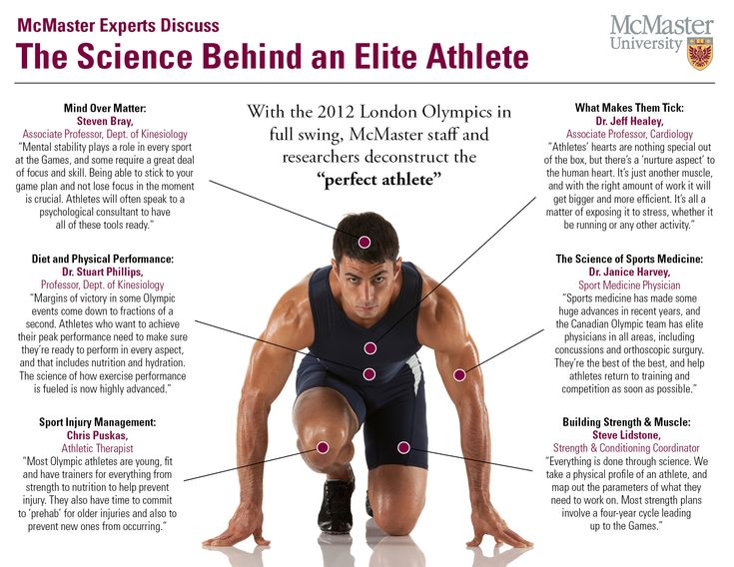
Case Studies
Several high-profile athletes have successfully used the scheduler to enhance their media presence.
For instance, a top-tier swimmer increased sponsorship deals by 30% through better media management.
Another athlete reported improved fan engagement and social media following after consistent media appearances.
Notes:
Image source: https://www.pinterest.nz/pin/294071050640243807/

Slide 8
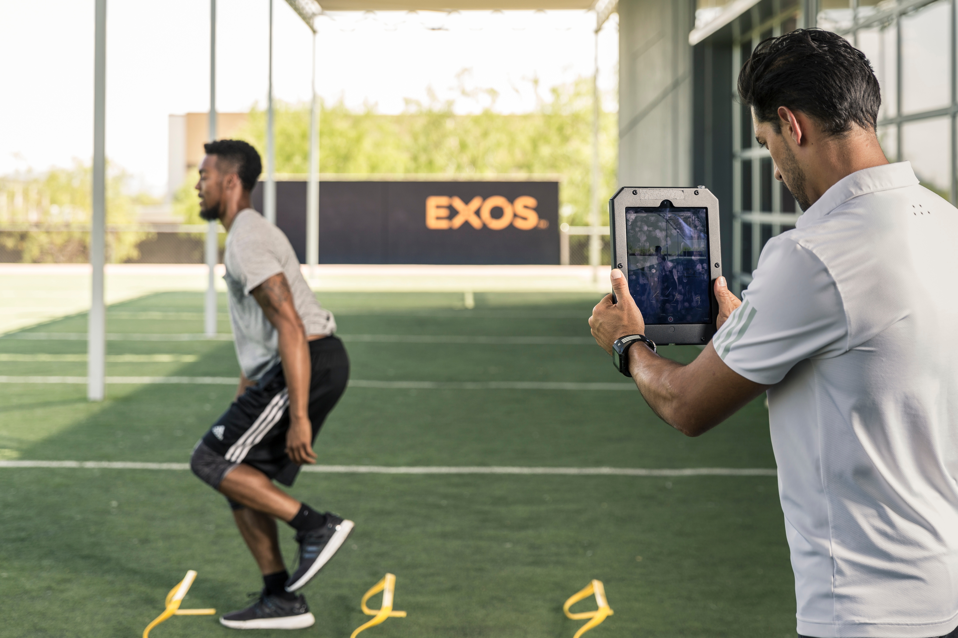
Conclusion and Future Outlook
The Athlete Media Appearance Scheduler represents a significant advancement in athlete management tools.
As the landscape of sports media continues to evolve, such tools will become increasingly important.
Future developments may include AI-driven recommendations for personalized media strategies.
Feel free to modify any part of the slides as per your requirements!
Notes:
Image source: https://blog.bridgeathletic.com/visualizing-data-athlete-management-systems

